Slide 1

MERN STACK
Getting Started
MongoDB · Express.js · React.js · Node.js
Full-Stack JavaScript Development — From Zero to Production

Slide 2

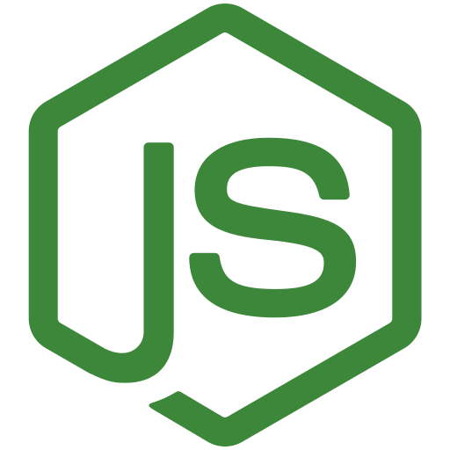


01 — FOUNDATIONS
What is Full Stack Development?
Frontend
Backend
Database
API
What the user sees and interacts with in the browser
Server-side logic that processes requests
Where application data is stored and retrieved
The bridge connecting frontend and backend
Request → Response Flow
User
Frontend
(React)
API / HTTP
Backend
(Node + Express)
Database
(MongoDB)
MERN Stack — Day 1
2

Slide 3

02 — THE STACK
What is MERN?
MongoDB
Database
M
Express.js
Backend framework
E
React.js
Frontend / UI
R
Node.js
JavaScript runtime
N
MERN lets you build a complete web application using JavaScript across the entire stack.
MERN Stack — Day 1
3

Slide 4
03 — RATIONALE
Why MERN?
JavaScript throughout the entire stack
Large ecosystem & community support
1
5
Component-based frontend with React
Strong, growing industry adoption
2
6
REST API development with Express
Smooth integration between frontend and backend
3
7
MongoDB's flexible, document-based database
4
MERN Stack — Day 1
4

Slide 5

04 — IN PRACTICE
Real-World MERN Application
Example: Online Shopping App — “Add to Cart”
1
2
3
User clicks “Add to Cart”
React sends an API request
Express receives the request
4
5
6
Node.js processes the request
MongoDB stores the cart data
Response returns → React updates UI
MERN Stack — Day 1
5

Slide 6
05 — INDUSTRY USE
Popular Applications Built Using MERN
Netflix
Instagram
Facebook
React powers much of the UI
Frontend built with React
React was created here; powers the UI
WhatsApp Web
Uber
Airbnb
Web client built with React
React & Node.js across the platform
React & Node.js in its tech stack
Discord
PayPal
Walmart Labs
React frontend, Node.js real-time backend
Node.js powers backend services
Node.js & React in various services
Note: production apps rarely use a “pure” MERN stack — they layer in TypeScript, GraphQL, Next.js, and microservices. The core building blocks (React + Node.js) are exactly what you're learning.
MERN Stack — Day 1
6

Slide 7
06 — BEFORE WE START
Prerequisites
Web Basics
JavaScript
• HTML
• Variables & Data Types
• CSS
• Operators
• Conditions & Loops
• Basic browser concepts
• Functions
• HTTP basics
• Arrays
• Objects
“We will revise the required JavaScript concepts before moving deeply into React.”
MERN Stack — Day 1
7

Slide 8



07 — SETUP
Development Environment & Tools
VS Code
Node.js
npm
Git / GitHub
MongoDB Atlas
Postman
Not covering full installation today — this is a conceptual overview of the toolkit.
MERN Stack — Day 1
8

Slide 9
08 — ORGANIZATION
How a MERN Project is Structured
my-mern-project
├─ frontend
│ └─ React
├─ backend
│ ├─ Node.js
│ └─ Express.js
└─ database
└─ MongoDB
As the project grows, this expands into:
client /
server /
models /
controllers /
routes /
middleware /
MERN Stack — Day 1
9

Slide 10
09 — THE JOURNEY AHEAD
Roadmap of the Entire Course
1
2
3
4
5
JavaScript
React
React Hooks
Context / Redux
Node.js
6
7
8
9
10
Express.js
REST APIs
MongoDB
Mongoose
Authentication
11
12
13
14
15
Full MERN Integration
Testing
Git & GitHub
Deployment
Final Project
MERN Stack — Day 1
10

Slide 11

Questions?
MERN Stack — Day 1
11

